Slide 1
Digital Design & Computer Arch. Lecture 18a: VLIW
Prof. Onur Mutlu
ETH Zürich
Spring 2020
30 April 2020

Slide 2
Approaches to (Instruction-Level) Concurrency
Pipelining
Out-of-order execution
Dataflow (at the ISA level)
Superscalar Execution
VLIW
Systolic Arrays
Decoupled Access Execute
Fine-Grained Multithreading
SIMD Processing (Vector and array processors, GPUs)

Slide 3
VLIW

Slide 4
VLIW Concept
Superscalar
Hardware fetches multiple instructions and checks dependencies between them
VLIW (Very Long Instruction Word)
Software (compiler) packs independent instructions in a larger “instruction bundle” to be fetched and executed concurrently
Hardware fetches and executes the instructions in the bundle concurrently
No need for hardware dependency checking between concurrently-fetched instructions in the VLIW model

Slide 5
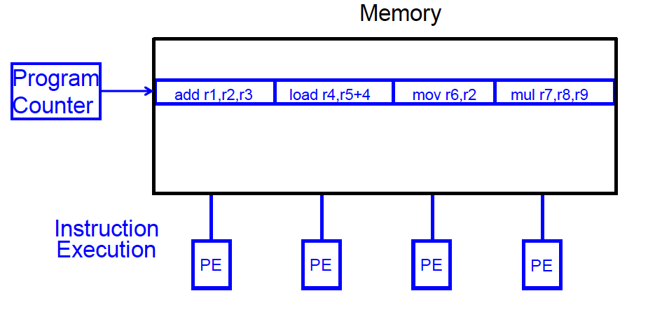
VLIW Concept
Fisher, “Very Long Instruction Word architectures and the ELI-512,” ISCA 1983.
ELI: Enormously longword instructions (512 bits)

Slide 6
VLIW (Very Long Instruction Word)
A very long instruction word consists of multiple independent instructions packed together by the compiler
Packed instructions can be logically unrelated (contrast with SIMD/vector processors, which we will see soon)
Idea: Compiler finds independent instructions and statically schedules (i.e. packs/bundles) them into a single VLIW instruction
Traditional Characteristics
Multiple functional units
All instructions in a bundle are executed in lock step
Instructions in a bundle statically aligned to be directly fed into the functional units

Slide 7
VLIW Performance Example (2-wide bundles)
lw $t0, 40($s0)
add $t1, $s1, $s2
sub $t2, $s1, $s3 and $t3, $s3, $s4 or $t4, $s1, $s5
sw $s5, 80($s0)
Ideal IPC = 2
Actual IPC = 2 (6 instructions issued in 3 cycles)

Slide 8
VLIW Lock-Step Execution
Lock-step (all or none) execution: If any operation in a VLIW instruction stalls, all instructions stall
In a truly VLIW machine, the compiler handles all dependency-related stalls, hardware does not perform dependency checking
What about variable latency operations?

Slide 9
VLIW Philosophy
Philosophy similar to RISC (simple instructions and hardware)
Except multiple instructions in parallel
RISC (John Cocke, 1970s, IBM 801 minicomputer)
Compiler does the hard work to translate high-level language code to simple instructions (John Cocke: control signals)
And, to reorder simple instructions for high performance
Hardware does little translation/decoding → very simple
VLIW (Josh Fisher, ISCA 1983)
Compiler does the hard work to find instruction level parallelism
Hardware stays as simple and streamlined as possible
Executes each instruction in a bundle in lock step
Simple → higher frequency, easier to design

Slide 10
Commercial VLIW Machines
Multiflow TRACE, Josh Fisher (7-wide, 28-wide)
Cydrome Cydra 5, Bob Rau
Transmeta Crusoe: x86 binary-translated into internal VLIW
TI C6000, Trimedia, STMicro (DSP & embedded processors)
Most successful commercially
Intel IA-64
Not fully VLIW, but based on VLIW principles
EPIC (Explicitly Parallel Instruction Computing)
Instruction bundles can have dependent instructions
A few bits in the instruction format specify explicitly which instructions in the bundle are dependent on which other ones

Slide 11
VLIW Tradeoffs
Advantages
+ No need for dynamic scheduling hardware → simple hardware
+ No need for dependency checking within a VLIW instruction → simple hardware for multiple instruction issue + no renaming
+ No need for instruction alignment/distribution after fetch to different functional units → simple hardware
Disadvantages
-- Compiler needs to find N independent operations per cycle
-- If it cannot, inserts NOPs in a VLIW instruction
-- Parallelism loss AND code size increase
-- Recompilation required when execution width (N), instruction latencies, functional units change (Unlike superscalar processing)
-- Lockstep execution causes independent operations to stall
-- No instruction can progress until the longest-latency instruction completes

Slide 12
VLIW Summary
VLIW simplifies hardware, but requires complex compiler techniques
Solely-compiler approach of VLIW has several downsides that reduce performance
-- Too many NOPs (not enough parallelism discovered)
-- Static schedule intimately tied to microarchitecture
-- Code optimized for one generation performs poorly for next
-- No tolerance for variable or long-latency operations (lock step)
++ Most compiler optimizations developed for VLIW employed in optimizing compilers (for superscalar compilation)
Enable code optimizations
++ VLIW successful when parallelism is easier to find by the compiler (traditionally embedded markets, DSPs)

Slide 13
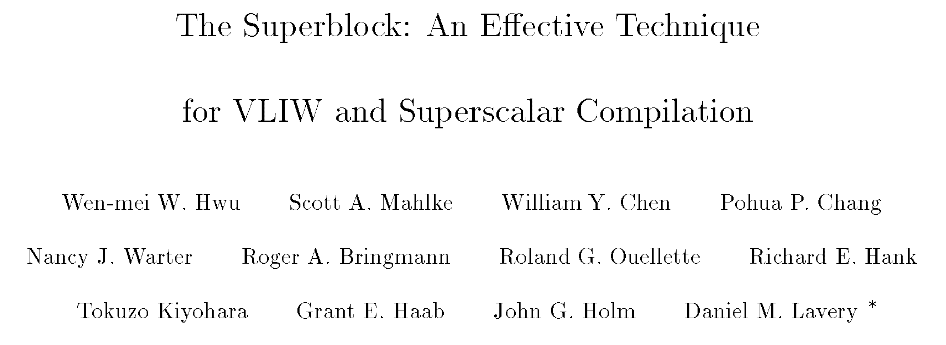
An Example Work: Superblock
Hwu et al., The superblock: An effective technique for VLIW and superscalar compilation.
The Journal of Supercomputing, 1993.
Lecture Video on Static Instruction Scheduling
https://www.youtube.com/watch?v=isBEVkIjgGA

Slide 14
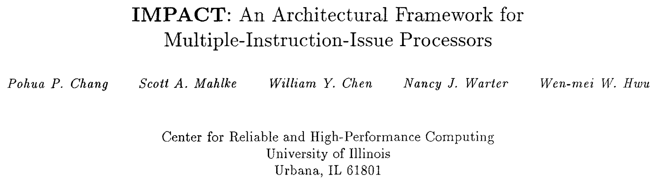
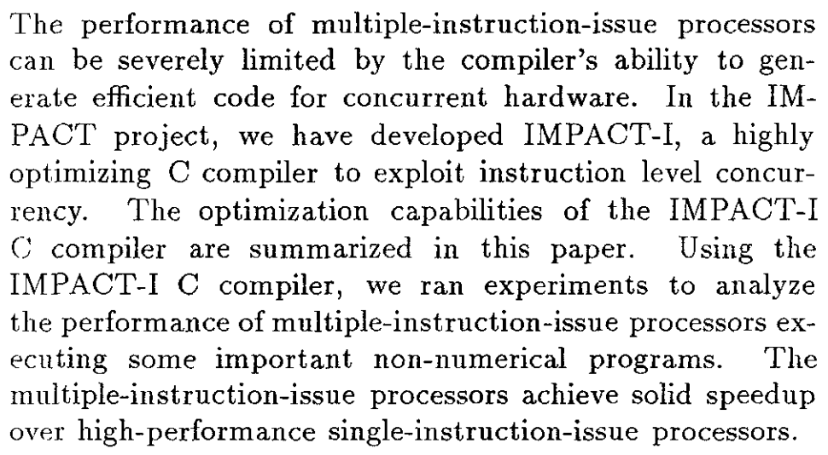
Another Example Work: IMPACT
Chang et al., IMPACT: an architectural framework for multiple-instruction-issue processors. ISCA 1991.

Slide 15
Digital Design & Computer Arch. Lecture 18a: VLIW
Prof. Onur Mutlu
ETH Zürich
Spring 2020
30 April 2020

